Slide 1

Bachelors of Engineering
Mini-Project Phase 1
Department of Electronics Engineering
Sardar Patel Institute of Technology
Munshi Nagar, Andheri(W), Mumbai-400058
UNIVERSITY OF MUMBAI
2017-2018

Slide 2
A PRESENTATION ON
Low Cost Real-time Meeting Room
Occupancy Indicating System
By
Chirag Shah
&
Srijal Poojari

Slide 3
Field survey: Environment Description
A corporate office of 400 employees: 250 employees on 7th floor, 150 employees on 3rd floor
7th floor has 10 meeting rooms and 3rd floor has 5 meeting rooms
Anyone can book any meeting room for any time (if the room is available) using a mobile app
This is an open office – hence if anyone wants to have a discussion then they need to go to a meeting room
Hence meeting rooms are always in demand

Slide 4
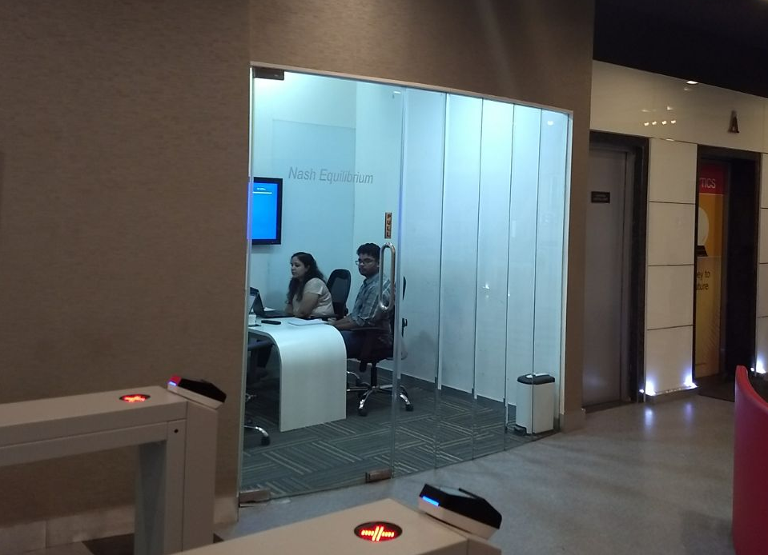

Slide 5
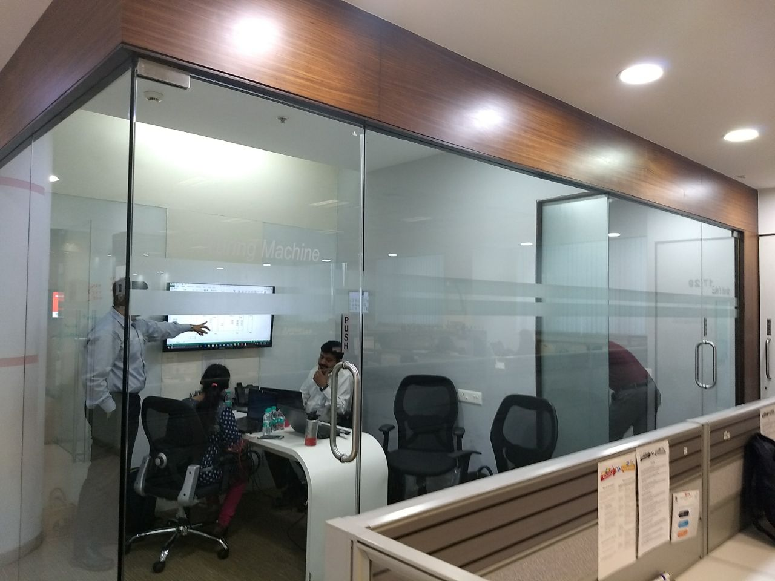

Slide 6
Problem Definition
If someone wants to have a meeting spontaneously without booking the room then the he/she will have to go from room to room to check the occupancy status of the room
Someone may book the room but if the meeting is cancelled then he/she may not cancel the booking, this may stop others form using it during that time since there is no way to check the occupancy status without actually going to the room
If a meeting is going on without booking the room the meeting can be interrupted by the person who had previously booked the room

Slide 7
Hypothesis
If there was a real-time meeting room occupancy monitoring system then users could remotely check in real-time
If the room is occupied or not
If a room is booked but not occupied
If a room is not booked and not occupied
The mobile app can use the data to cancel bookings if the room is unoccupied
This will lead to optimal utilization of the meeting rooms.

Slide 8
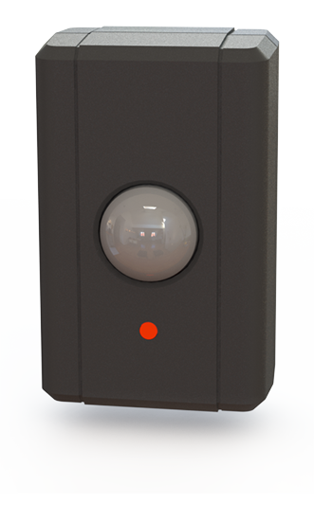
Market Survey: Workscape
http://www.workscape.io/products/manage/smart-sensors/
http://www.workscape.io/wp-content/uploads/2017/08/ChargeSpot-Whitepaper-Unlocking-Employee-Productivity-with-Sensor-Technology.pdf
$15 per room / month
=$2700 15 rooms/year

Slide 9

Market Survey: OccupEye
https://www.occupeye.com/
http://www.occupeye.com/wp-content/themes/OccupEye/brochure/OCC-Brochure.pdf

Slide 10
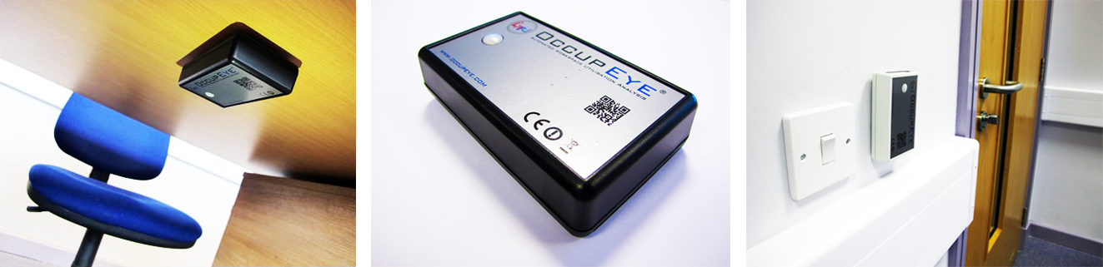
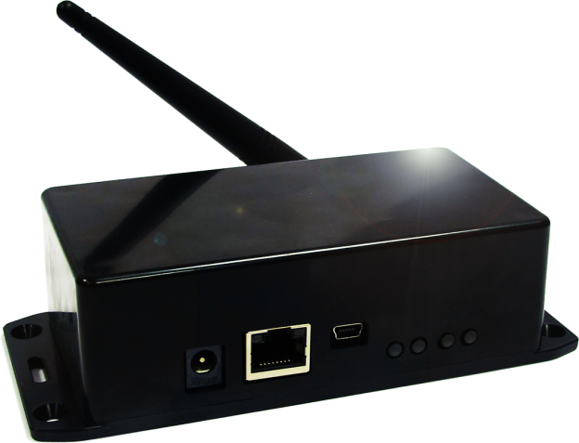
Market Survey: OccupEye

Slide 11
Literature Survey
Tran et al. , " A Smart Meeting Room Scheduling and Management System with Utilization Control and Ad-hoc Support Based on Real-Time Occupancy Detection”, in IT Convergence and Security (ICITCS), 2013 International Conference on, 2013.
“ In this paper, we present a smart meeting room scheduling and management system which detect occupancy status of meeting rooms in real-time and integrate this information into the scheduling application to support ad-hoc meetings and increase room utilization. Our system is a simple, ease-of-implementation solution based on PIR sensor fusion devices and Ethernet connectivity. Occupancy data is sent to a central application server by UDP over IP protocols. On this server, a web application is developed and hosted to not only allow people book rooms for their meetings, but also check the utilization of these rooms based on predefined policies.”

Slide 12
Solution Design
We will use a PIR sensor to detect occupancy
The sensor will be connected to an Atmel microcontroller which will relay the information to a central device via radio modules configured in a mesh configuration
The central device will push the data to the internet using a WiFi module
All the devices will be battery powered (except the central device)
We will create a complete end-to-end product including getting PCBs manufactured for the devices and designing the web interface
We will create a dashboard which will show the real time status of meeting room occupancy

Slide 13
Proposed Outcomes
We will create a real-time wireless conference room occupancy monitoring system
Each room will have one or more devices which will detect the occupancy of the room
This data will be uploaded to a central server/device over which will keep track of the occupancy of all the rooms
The occupancy of each room can be viewed on a web interface
This data can be integrated with the existing mobile app(this is outside the scope of this project)

Slide 14
Project Plan
Week | Objective
15th-21st Jan | Research on feasibility of proposed project
22nd-28th Jan | Topic Finalization
29th – 4th Feb | Research on wireless options and available sensors
5th – 11th Feb | Range Testing of radio modules
12th – 18th Feb | Obtain the required components and assemble 3-4 devices on breadboards
19th -25th Feb | Complete Meshing of NRF24L01 radio modules
26th-4th March | Integrate PIR sensors and make system battery powered

Slide 15
Project Plan
Week | Objective
5th – 11th March | Integrate WiFi module and develop the web interface
12th – 18th March | No work done due to MSE
19th – 25th March | Develop the web interface
26th Mar– 1st Apr | Design PCB for the devices and hosts
2nd – 8th Apr | Final Submission
9th – 15th Apr | Documentation

Slide 16
Hardware Requirements
PIR sensors
NRF24L01 radio modules
Esp8266 12-F modules
Atmega 328 uCs
PCBs

Slide 17
References
Sparkfun.com, “nRF24L01+ Transceiver Hookup Guide”, [Online]. Available:https://learn.sparkfun.com/tutorials/nrf24l01-transceiver-hookup-guide [Accessed: 10-Feb-2018]
geekstips.com, “Internet of Things Project – Communication between ESP8266 modules”, [Online]. Available: https://www.geekstips.com/two-esp8266-communication-talk-each-other/ [Accessed: 10-Feb-2018]
Scargill, “Networking the nef24l01”, [Online]. Available:https://scargill.wordpress.com/2013/05/17/networking-the-nrf24l01/ [Accessed: 10-Feb-2018]

Slide 18
THANK YOU

